Slide 1
Advanced FTC Code
panic!
https://github.com/JimWright4089/FIRSTWorkshops

Slide 2
Intro
Things covered in this class:
Andriod Studio
Getting the code
FTC dashboard
FTC Road Runner

Slide 3
Andriod Studio
A lot more complicated than OnBoard Java
A lot more flexible as well.
A good tool to know

Slide 4
Android Studio Setup
Download/Install JDK
https://www.oracle.com/java/technologies/downloads/
Download/Install Android Studio
https://developer.android.com/

Slide 5
FTC Project
Github has it.
https://github.com/FIRST-Tech-Challenge/FtcRobotController
You can download and use it from Github.
Better to fork the code into your Github project. This lets your team check in code.
Clone this project onto your hard drive.

Slide 6
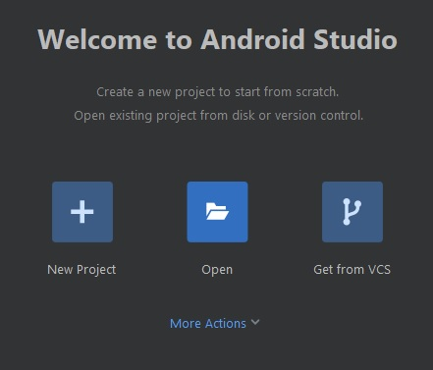
FTC Project
In Android Studio choose open.
Find the cloned project, it will have a little Andriod symbol on it.
It will take a while, to get the code and all of the libraries loaded the first time.

Slide 7
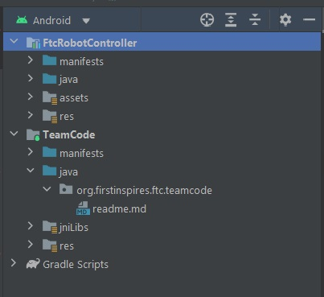
Your Code here!
Once everything is loaded, the explorer will be on the left.
Open up the Team Code directory.

Slide 8
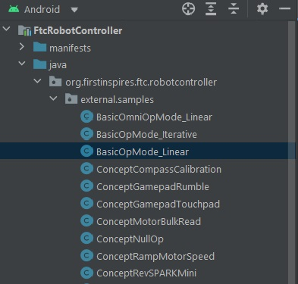
Samples
In the example folder there are, well, examples of code. Copy those to your Team code.

Slide 9
FTC dashboard
The FTC dashboard acts like the FRC dashboard.
It is a panel that lets you see what your robot is doing.
It’s not official.
https://acmerobotics.github.io/ftc-dashboard/

Slide 10
Setup the PC
It needs node.js
https://nodejs.org/en/download/
It also needs yarn.
After node is installed, open a command prompt and type ‘npm install --global yarn’

Slide 11
build.dependencies.gradle
repositories {
mavenCentral()
google() // Needed for androidx
flatDir {
dirs rootProject.file('libs')
}
maven { url = 'https://maven.brott.dev/' }
}

Slide 12
build.dependencies.gradle
implementation 'org.tensorflow:tensorflow-lite-task-vision:0.2.0'
implementation 'androidx.appcompat:appcompat:1.2.0'
implementation 'org.firstinspires.ftc:gameAssets-FreightFrenzy:1.0.0'
implementation 'com.acmerobotics.dashboard:dashboard:0.4.4'
}

Slide 13
Adding more code to your code.
import com.acmerobotics.dashboard.*;
// Declare OpMode members.
FtcDashboard dashboard = FtcDashboard.getInstance();
public void init() {
telemetry = dashboard.getTelemetry();

Slide 14
Here is where I did odd things
I could not get the import:
import com.acmerobotics.dashboard.*;
It’s really hard to describe what I did. I sort of did a bunch of weird things.
The thing I think made the difference was to clone the dashboard repo, open it in the same project as FTCRobotController

Slide 15
Here is where I did odd things
I then build the whole thing as which Android Studio told me to update things.
I updated the things.
Then the dashboard code stopped building, and I closed it.
After that the import, well, imported.
I would scrape everything off my machine and start again but it’s 11pm last night.

Slide 16
The dashboard web site.
Navigate to 192.168.49.1:8080/dash with a phone RC or 192.168.43.1:8080/dash with a Control Hub.

Slide 17
The dashboard web site.

Slide 18
FTC Road Runner
Hey, oh, look at the time….
There is something called Road Runner.
It’s a path planning app.
When you combine Road Runner and Dashboard it looks like the following:

Slide 19
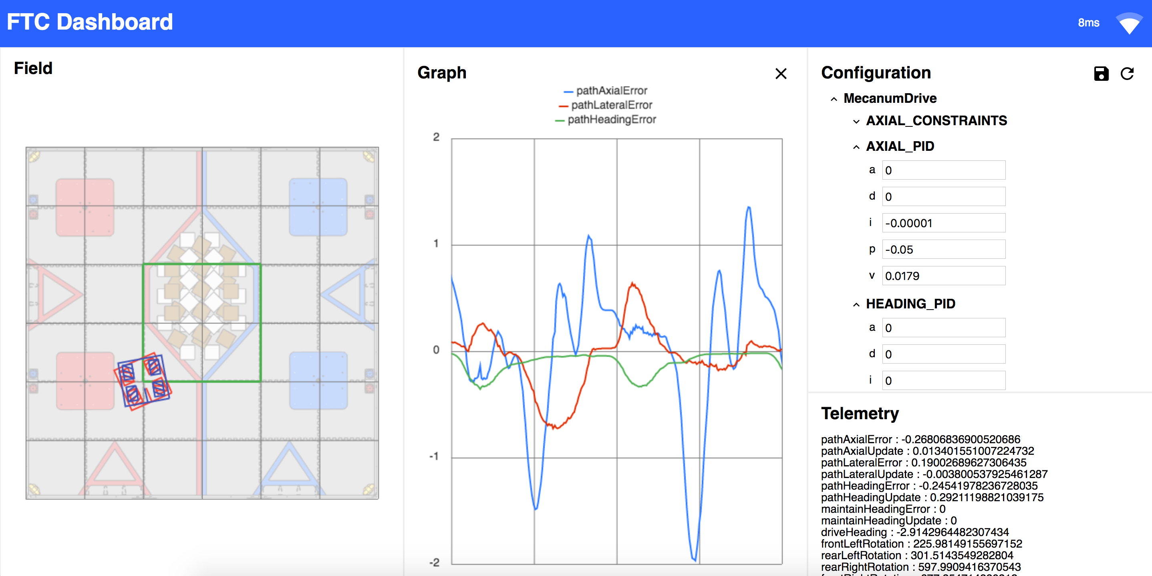
FTC Road Runner

